Slide 1

Chapter 16 – Basic Data Structures

Slide 2

Chapter Goals
To understand the implementation of linked lists and array lists
To analyze the efficiency of fundamental operations of lists and arrays To implement the stack and queue data types
To implement a hash table and understand the efficiency of its operations

Slide 3
Implementing Linked Lists - The Node Class
We will implement a simplified, singly-linked list.
A linked list stores elements in a sequence of nodes.
A Node object stores an element and a reference to the next node.
private inner class public instance variables
public class LinkedList
{
. . .
class Node
{
public Object data; public Node next;
}
}

Slide 4
Implementing Linked Lists - The Node Class
A linked list object holds a reference to the first node:
Each node holds a reference to the next node.
public class LinkedList
{
private Node first;
public LinkedList() { first = null; } public Object getFirst()
{
if (first == null) { throw new NoSuchElementException(); } return first.data;
}
}

Slide 5
Implementing Linked Lists - Adding and Removing the First Element
When adding or removing the first element, the reference to the first node must be updated.
public class LinkedList
{
. . .
public void addFirst(Object element)
{
Node newNode = new Node(); newNode.data = element; newNode.next = first;
first = newNode;
}
. . .
}

Slide 6
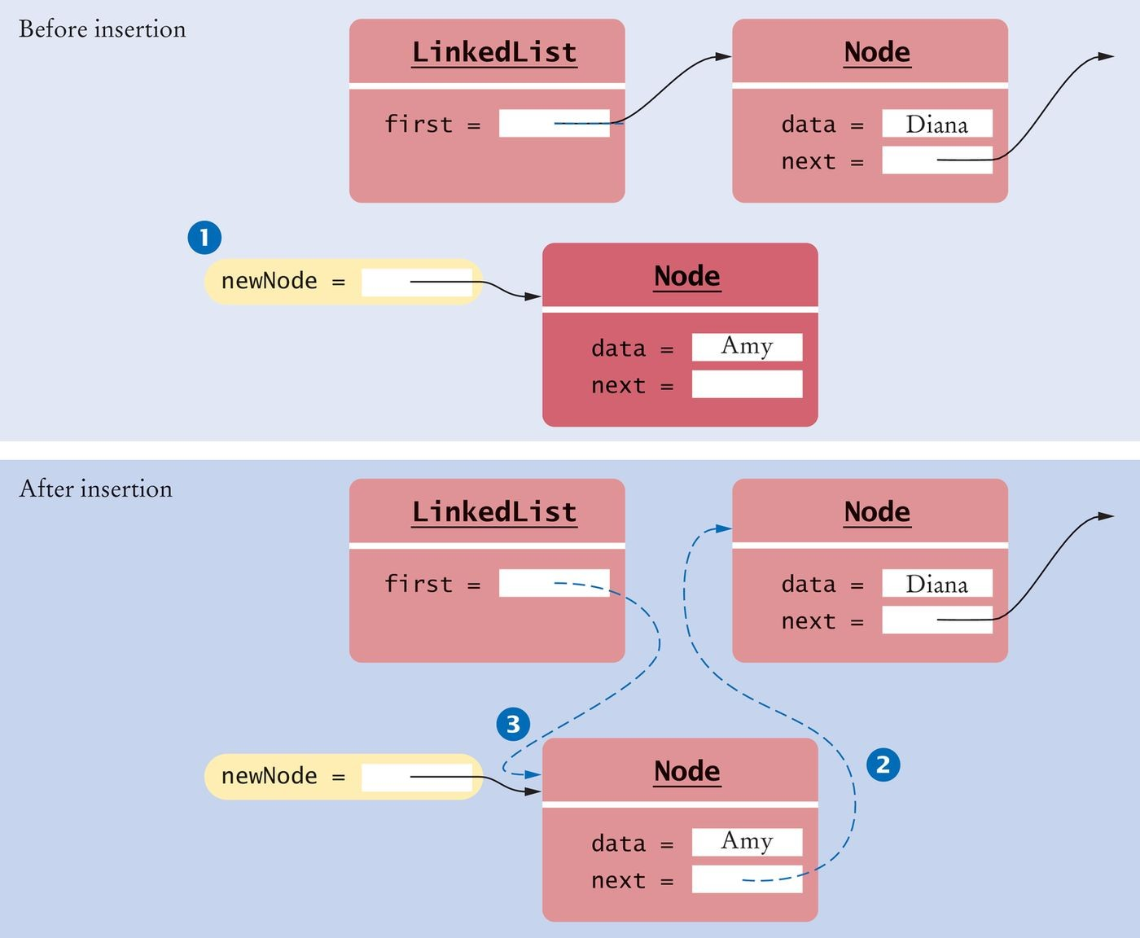
Implementing Linked Lists - Adding the First Element
Figure 1 Adding a Node to the Head of a Linked List

Slide 7
Implementing Linked Lists - Removing the First Element
The data of the first node are saved and later returned as the method result. The successor of the first node becomes the first node of the shorter list.
The old node is eventually recycled by the garbage collector.
public class LinkedList
{
. . .
public Object removeFirst()
{
if (first == null) { throw new NoSuchElementException(); } Object element = first.data;
first = first.next; return element;
}
. . .
}

Slide 8
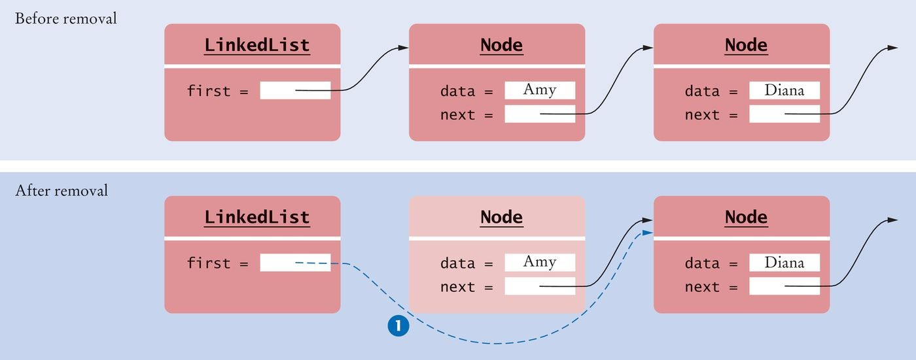
Implementing Linked Lists - Removing the First Element
Figure 2 Removing the First Node from a LinkedList

Slide 9
The Iterator Class
Our simplified ListIterator interface has methods: next, hasNext, remove, add, and set.
Our LinkedList class declares a private inner class LinkedListIterator.
LinkedListIterator implements our simplified ListIterator interface. As an inner class LinkedListIterator has access to
The instance variable first
The private Node class.
A list iterator object has:
A reference to the the currently visited node, position
A reference to the last node before that, previous
A isAfterNext flag to track when the next method has been called.

Slide 10
The Iterator Class
The LinkedListIterator class:
public class LinkedList
{
. . .
public ListIterator listIterator()
{
return new LinkedListIterator();
}
class LinkedListIterator implements ListIterator
{
private Node position; private Node previous; private boolean isAfterNext; public LinkedListIterator()
{
position = null; previous = null; isAfterNext = false;
}
. . .
}
}

Slide 11
Advancing an Iterator
To advance an iterator:
Update the position
Remember the old position for the remove method.
The next method:
class LinkedListIterator implements ListIterator
{
. . .
public Object next()
{
if (!hasNext()) { throw new NoSuchElementException(); } previous = position; // Remember for remove
isAfterNext = true;
if (position == null)
{
position = first;
}
else
{
position = position.next;
}
return position.data;
}
. . .
}

Slide 12
Advancing an Iterator
The iterator is at the end if the list is empty (first == null) or if there is no element after the current position (position.next == null).
The hasNext method:
class LinkedListIterator implements ListIterator
{
. . .
public boolean hasNext()
{
if (position == null)
{
return first != null;
}
else
{
return position.next != null;
}
}
. . .
}

Slide 13
Removing an Element
If this is the first element:
Call removeFirst
Otherwise, update the next reference of the previous node
Update isAfterNext to disallow another call to remove. The remove method:
class LinkedListIterator implements ListIterator
{
. . .
public void remove()
{
if (!isAfterNext) { throw new IllegalStateException(); } if (position == first)
{
removeFirst();
}
else
{
previous.next = position.next;
}
position = previous; isAfterNext = false;
}
. . .
}

Slide 14
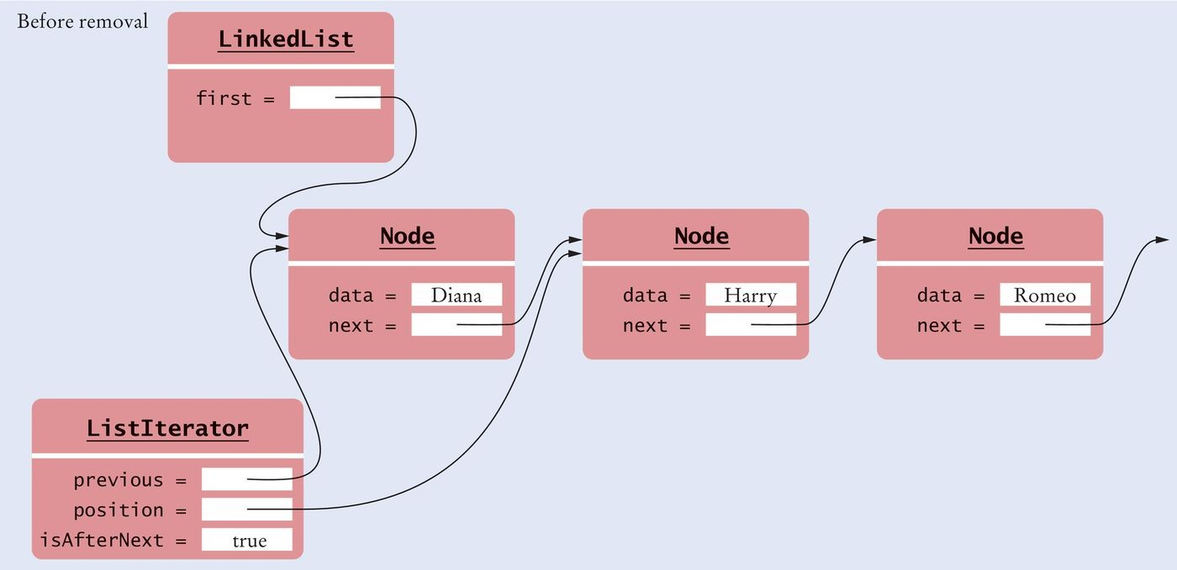
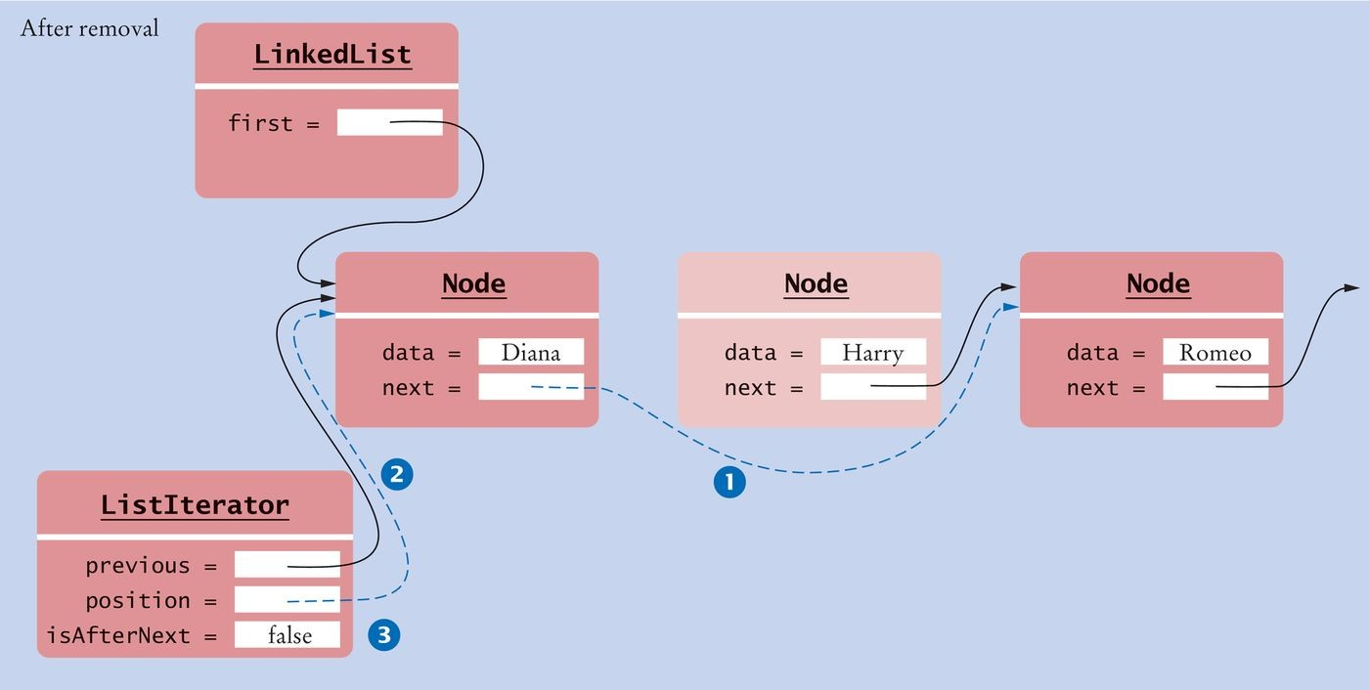
Removing an Element
Figure 3 Removing a Node from the Middle of a Linked List

Slide 15
Adding an Element
After adding the new element
set the isAfterNext flag to false to disallow a subsequent call to the remove or set method
The add method:
class LinkedListIterator implements ListIterator
{
. . .
public void add(Object element)
{
if (position == null)
{
addFirst(element); position = first;
}
else
{
Node newNode = new Node(); newNode.data = element;
newNode.next = position.next; position.next = newNode; position = newNode;
}
isAfterNext = false;
}
. . .
}

Slide 16
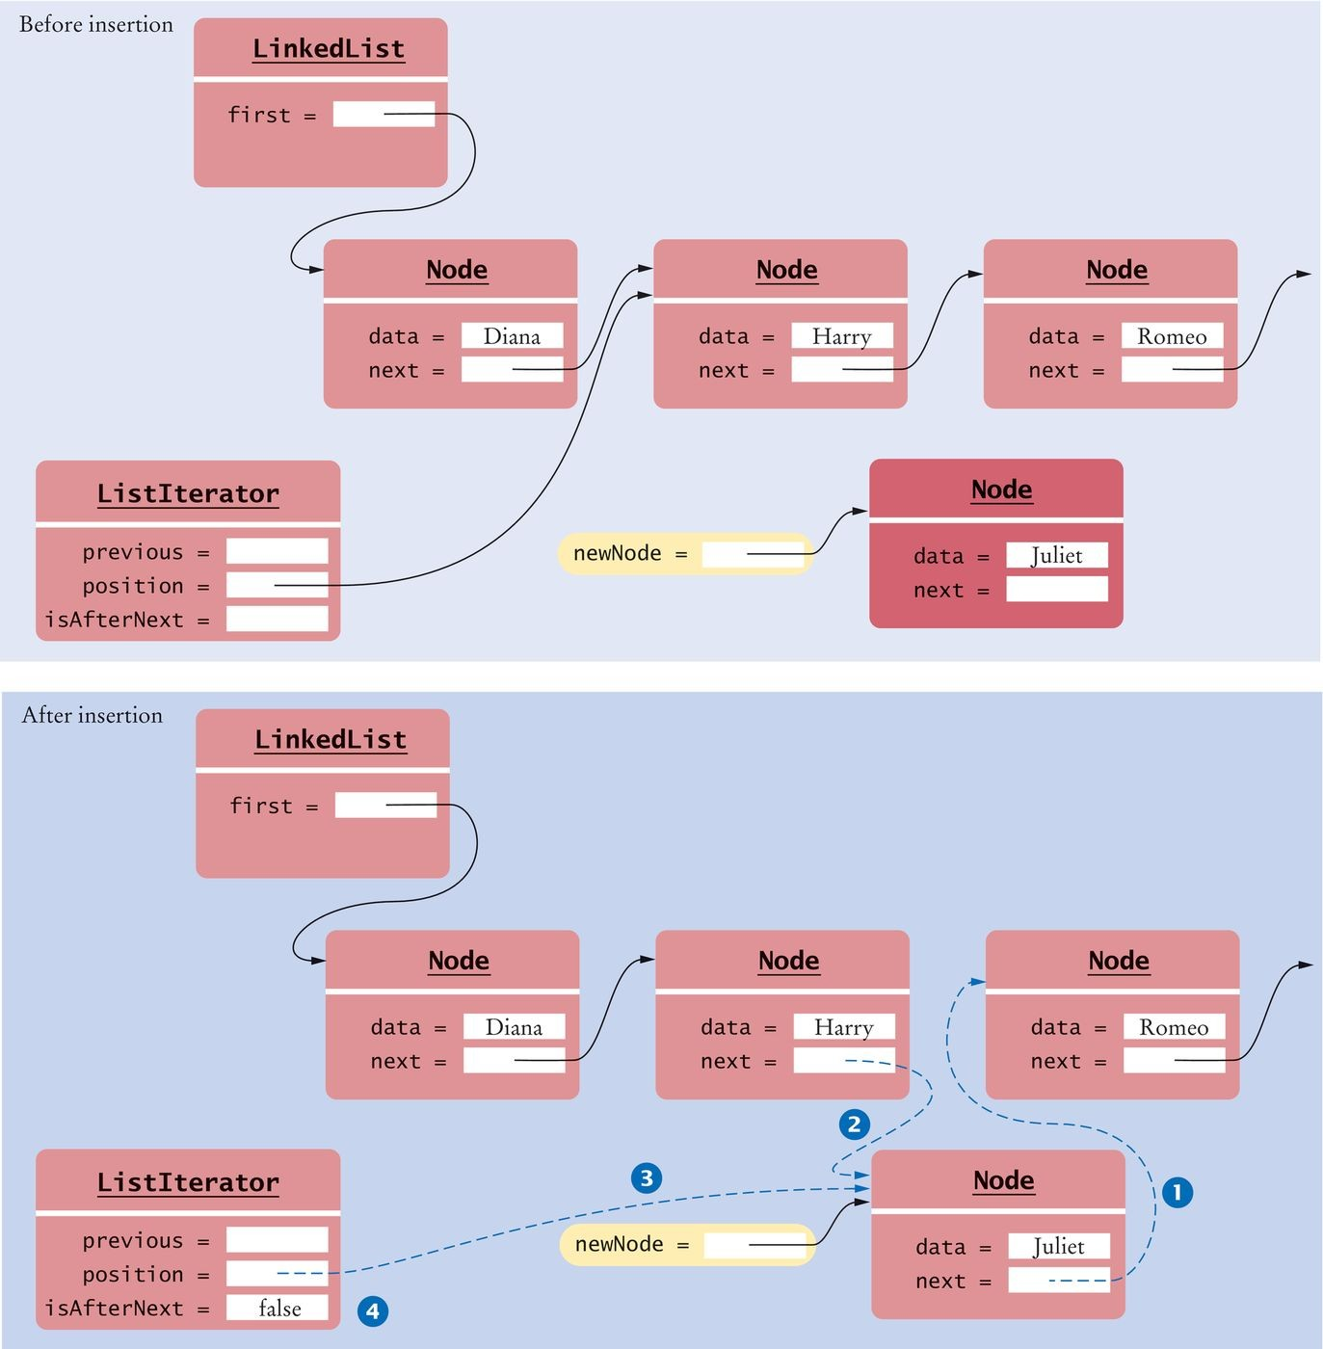
Adding an Element
Figure 4 Adding a Node to the Middle of a Linked List

Slide 17
Setting an Element to a Different Value
Set method changes the data in the previously visited element. Must follow a call to next.
The set method:
public void set(Object element)
{
if (!isAfterNext) { throw new IllegalStateException(); } position.data = element;
}

Slide 18

Efficiency of Linked List Operations
To get the k^{th} element of a linked list, you start at the beginning of the list and advance the iterator k times.
To get to the k^{th} node of a linked list, one must skip over the preceding nodes.

Slide 19
Efficiency of Linked List Operations
When adding or removing an element, we update a couple of references in a constant number of steps.
Adding and removing an element at the iterator position in a linked list takes O(1) time.

Slide 20
Efficiency of Linked List Operations
To add an element at the end of the list
Must get to the end - an O(n) operation Add the element O(1) operation
Adding to the end of a linked list in our implementation takes O(n) time If the linked list keeps a reference to last as well as first
The time is reduced to constant time: O(1)
public class LinkedList
{
private Node first; private Node last;
. . .
}
We will conclude that adding to the end of a linked list is O(1).

Slide 21
Efficiency of Linked List Operations
To remove an element from the end of the list:
Need a reference to the next-to-last element so that we can set its next reference to null Takes n-1 iterations
Removing an element from the end of the list is O(n).

Slide 22
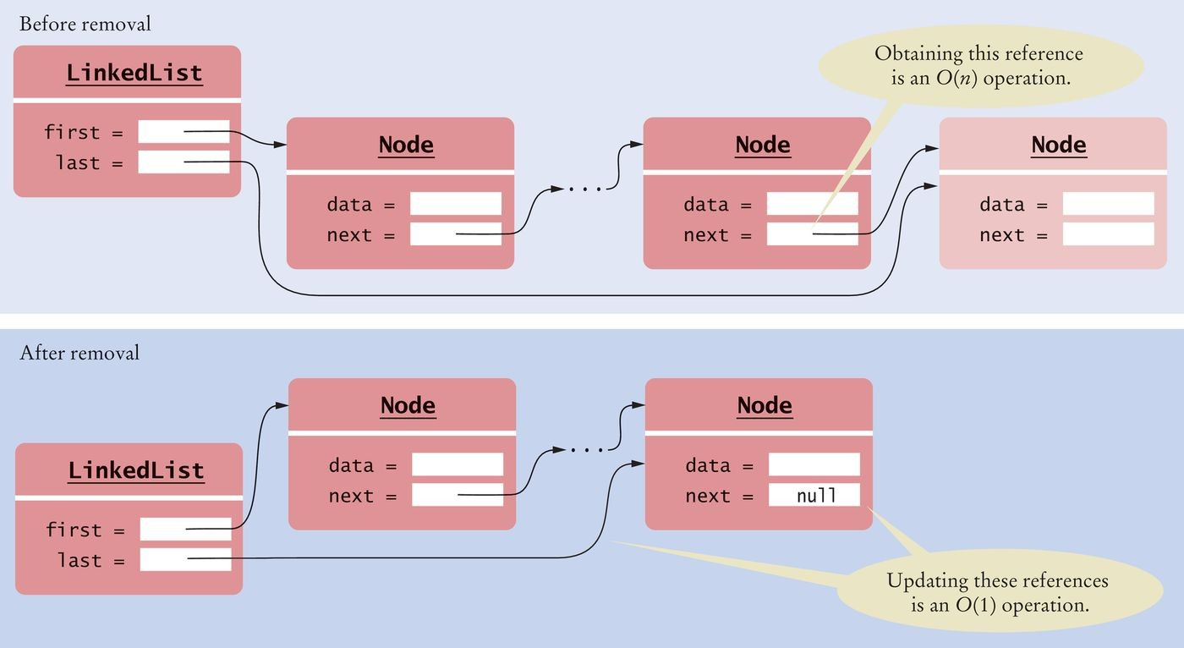
Efficiency of Linked List Operations
Figure 5 Removing the Last Element of a Singly-Linked List

Slide 23
Efficiency of Linked List Operations
In a doubly-linked list, each node has a reference to the previous node in addition to the next one.
public class LinkedList
{
. . .
class Node
{
public Object data; public Node next; public Node previous;
}
}

Slide 24
Efficiency of Linked List Operations
In a doubly-linked list, removal of the last element takes a constant number of steps.
last = last.previous; last.next = null;

Slide 25
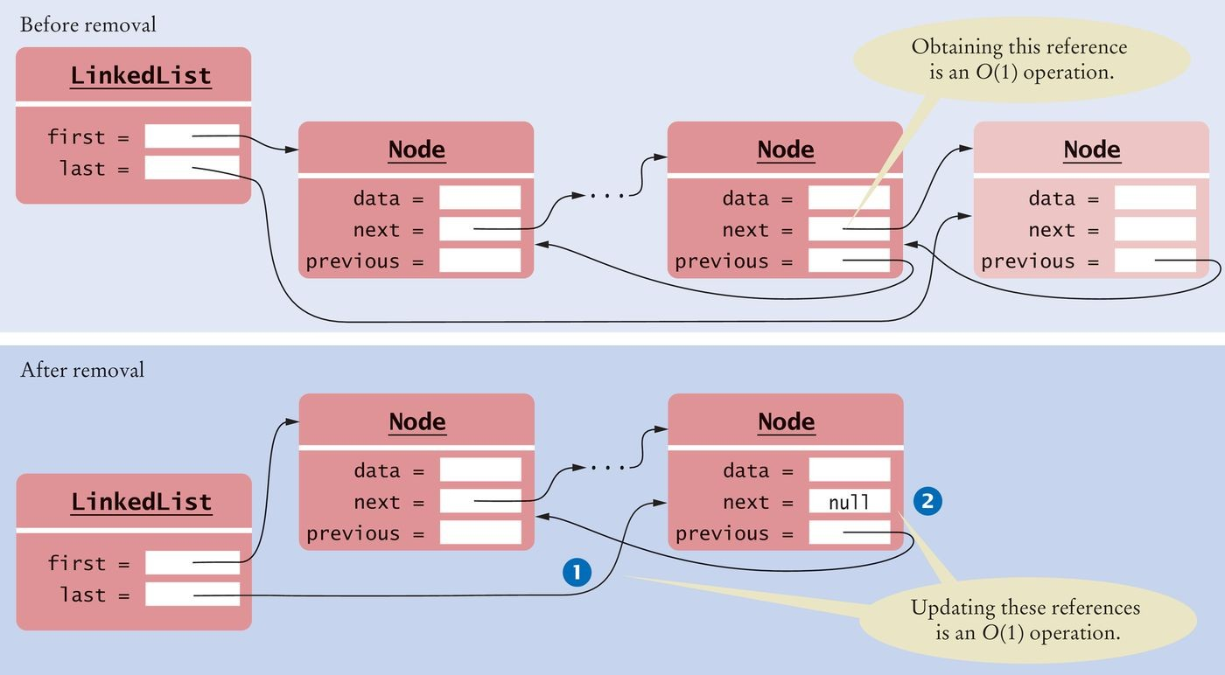
Efficiency of Linked List Operations
Figure 6 Removing the Last Element of a Doubly-Linked List

Slide 26
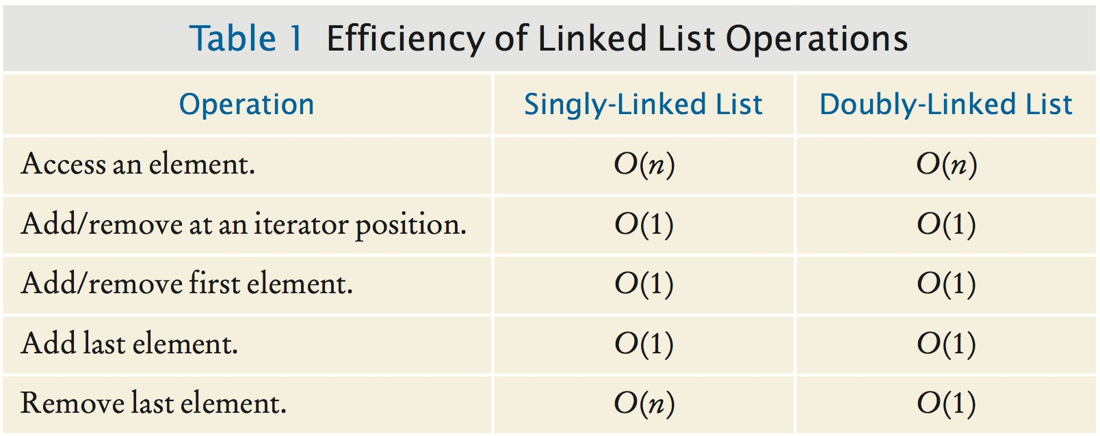
Efficiency of Linked List Operations

Slide 27
section_1/LinkedList.java
1 import java.util.NoSuchElementException;
2
3 /**
A linked list is a sequence of nodes with efficient
element insertion and removal. This class
contains a subset of the methods of the standard
java.util.LinkedList class.
8 */
9 public class LinkedList
10 {
11 private Node first;
12
13
14
15
16
17
18
19
20
21
22
23
24
25
26
27
28
29
30
31
32
33
34
/**
Constructs an empty linked list.
*/
public LinkedList()
{
first = null;
}
/**
Returns the first element in the linked list.
@return the first element in the linked list
*/
public Object getFirst()
{
if (first == null) { throw new NoSuchElementException(); } return first.data;
}
/**
Removes the first element in the linked list.
@return the removed element
*/

Slide 28
section_1/ListIterator.java
1 /**
A list iterator allows access of a position in a linked list.
This interface contains a subset of the methods of the
standard java.util.ListIterator interface. The methods for
backward traversal are not included.
6 */
7 public interface ListIterator
8 {
9 /**
Moves the iterator past the next element.
@return the traversed element
12 */
13 Object next();
14
15
16
17
18
19
20
21
22
23
24
25
26
27
28
29
30
31
32
33
/**
Tests if there is an element after the iterator position.
@return true if there is an element after the iterator position
*/
boolean hasNext();
/**
Adds an element before the iterator position
and moves the iterator past the inserted element.
@param element the element to add
*/
void add(Object element);
/**
Removes the last traversed element. This method may only be called after a call to the next() method.
*/
void remove();

Slide 29
Self Check 16.1
Trace through the addFirst method when adding an element to an empty list.
Answer: When the list is empty, first is null. A new Node is allocated. Its data instance variable is set to the element that is being added. It’s next instance variable is set to null because first is null. The first instance variable is set to the new node. The result is a linked list of length 1.

Slide 30
Self Check 16.2
Conceptually, an iterator is located between two elements (see Figure 9 in Chapter 15). Does the
position instance variable refer to the element to the left or the element to the right?
Answer: It refers to the element to the left. You can see that by tracing out the first call to next. It leaves position to refer to the first node.

Slide 31
Self Check 16.3
Why does the add method have two separate cases?
Answer: If position is null, we must be at the head of the list, and inserting an element requires updating the first reference. If we are in the middle of the list, the first reference should not be changed.

Slide 32
Self Check 16.4
Assume that a last reference is added to the LinkedList class, as described in Section 16.1.8. How does the add method of the ListIterator need to change?
Answer: If an element is added after the last one, then the last reference must be updated to point to the new element. After
position.next = newNode;
add
if (position == last) { last = newNode; }

Slide 33
Self Check 16.5
Provide an implementation of an addLast method for the LinkedList class, assuming that there is no
last reference.
Answer:
public void addLast(Object element)
{
if (first == null) { addFirst(element); } else
{
Node last = first;
while (last.next != null)
{
last = last.next;
}
last.next = new Node(); last.next.data = element;
}
}

Slide 34
Self Check 16.6
Expressed in big-Oh notation, what is the efficiency of the addFirst method of the LinkedList class? What is the efficiency of the addLast method of Self Check 5?
Answer: O(1) and O(n).

Slide 35
Self Check 16.7
How much slower is the binary search algorithm for a linked list compared to the linear search algorithm?
Answer: To locate the middle element takes n / 2 steps. To locate the middle of the subinterval to the left or right takes another n / 4 steps. The next lookup takes n / 8 steps. Thus, we expect almost n steps to locate an element. At this point, you are better off just making a linear search that, on average, takes n / 2 steps.

Slide 36
Static Classes
Every object of an inner class has a reference to the outer class.
It can access the instance variables and methods of the outer class.
If an inner class does not need to access the data of the outer class,
It does not need a reference.
Declare it static to save the cost of the reference.
Example: Declare the Node class of the LinkedList class as static:
public class LinkedList
{
. . .
static class Node
{
. . .
}
}

Slide 37
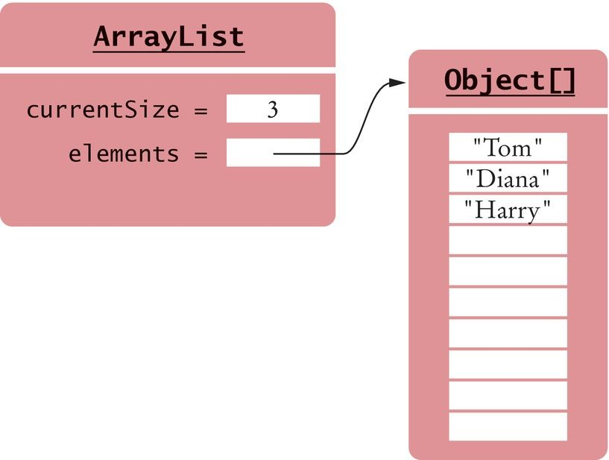
Implementing Array Lists
An array list maintains a reference to an array of elements. The array is large enough to hold all elements in the collection. When the array gets full, it is replaced by a larger one.
An array list has an instance field that stores the current number of elements.
Figure 7 An Array List Stores its Elements in an Array

Slide 38
Implementing Array Lists
Our ArrayList implementation will manage elements of type Object:
public class ArrayList
{
private Object[] elements; private int currentSize;
public ArrayList()
{
final int INITIAL_SIZE = 10; elements = new Object[INITIAL_SIZE]; currentSize = 0;
}
public int size() { return currentSize; }
. . .
}

Slide 39
Implementing Array Lists - Getting and Setting Elements
Providing get and set methods:
Check for valid positions
Access the internal array at the given position
Helper method to check bounds:
private void checkBounds(int n)
{
if (n < 0 || n >= currentSize)
{
throw new IndexOutOfBoundsException();
}
}

Slide 40
Implementing Array Lists - Getting and Setting Elements
The get method:
public Object get(int pos)
{
checkBounds(pos); return element[pos];
}
The set method:
public void set(int pos, Object element)
{
checkBounds(pos); elements[pos] = element;
}
Getting and setting an element can be carried out with a bounded set of instructions, independent of the size of the array list.
These are O(1) operations.

Slide 41
Removing or Adding Elements
To remove an element at position k, move the elements with higher index values.
The remove method:
public Object remove(int pos)
{
checkBounds(pos);
Object removed = elements[pos];
for (int i = pos + 1; i < currentSize; i++)
{
elements[i - 1] = elements[i];
}
currentSize--; return removed;
}
On average, n / 2 elements need to move.
Inserting a element also requires moving, on average, n /2 elements. Inserting or removing an array list element is an O(n) operation.

Slide 42
Removing or Adding Elements
Exception: adding an element after the last element
Store the element in the array Increment size
An O(1) operation
A the addLast method:
public boolean addLast(Object newElement)
{
growIfNecessary(); currentSize++;
elements[currentSize - 1] = newElement; return true;
}

Slide 43
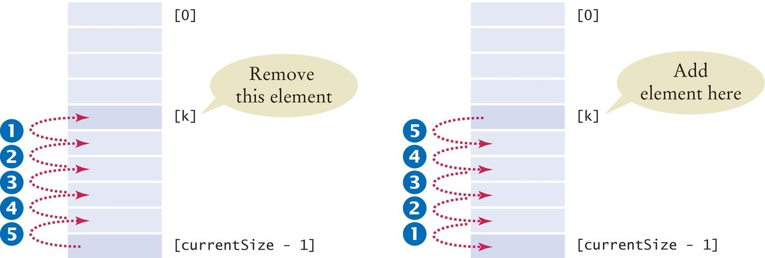
Removing or Adding Elements
Figure 8 Removing and Adding Elements

Slide 44

Growing the Internal Array
When an array list is completely full, we must move the contents to a larger array.

Slide 45
Growing the Internal Array
When the array is full:
Create a bigger array
Copy the elements to the new array New array replaces old
Reallocation is O(n).
The growIfNecessary method:
private void growIfNecessary()
{
if (currentSize == elements.length)
{
Object[] newElements = new Object[2 * elements.length]; for (int i = 0; i < elements.length; i++)
{
newElements[i] = elements[i];
}
elements = newElements;
}
}

Slide 46
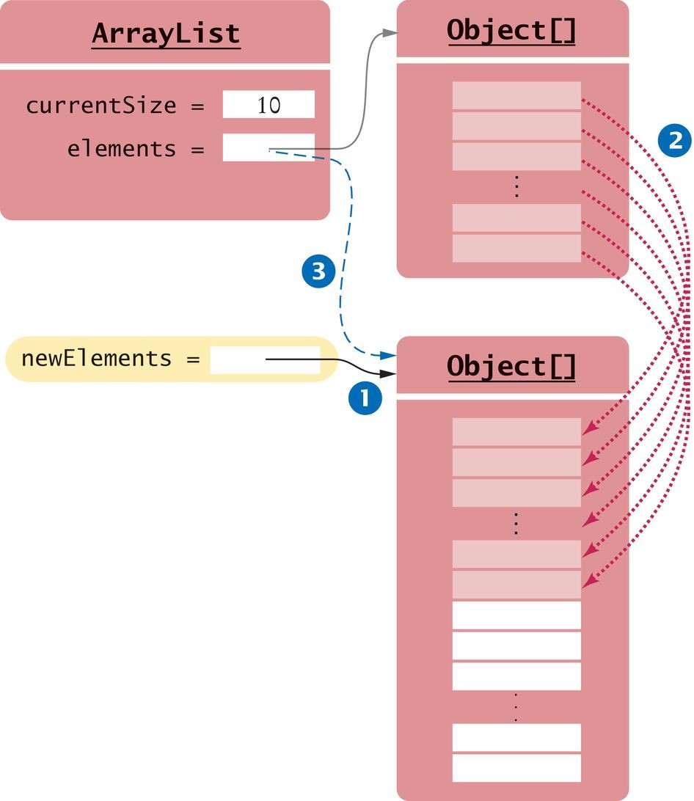
Growing the Internal Array
Figure 9 Reallocating the Internal Array

Slide 47
Growing the Internal Array
Reallocation seldom happens.
We amortize the cost of the reallocation over all the insertion or removals. Adding or removing the last element in an array list takes amortized O(1) time.
Written O(1)+

Slide 48
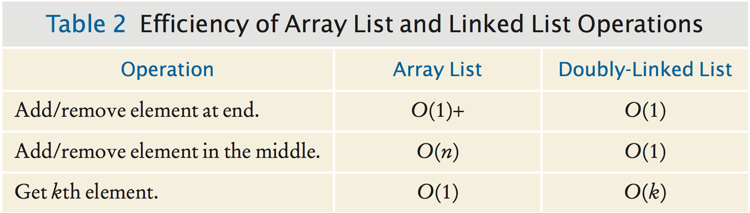
Efficiency of Array List and Linked List Operations

Slide 49
Self Check 16.8
Why is it much more expensive to get the kth element in a linked list than in an array list?
Answer: In a linked list, one must follow k links to get to the kth elements. In an array list, one can reach the kth element directly as elements[k].

Slide 50
Self Check 16.9
Why is it much more expensive to insert an element at the beginning of an array list than at the beginning of a linked list?
Answer: In a linked list, one merely updates references to the first and second node––a constant cost that is independent of the number of elements that follow. In an array list of size n, inserting an element at the beginning requires us to move all n elements.

Slide 51
Self Check 16.10
What is the efficiency of adding an element exactly in the middle of a linked list? An array list?
Answer: It is O(n) in both cases. In the case of the linked list, it costs O(n) steps to move an iterator to the middle.

Slide 52
Self Check 16.11
Suppose we insert an element at the beginning of an array list, and the internal array must be grown to hold the new element. What is the efficiency of the add operation in this situation?
Answer: It is still O(n). Reallocating the array is an O(n) operation, and moving the array elements also requires O(n) time.

Slide 53
Self Check 16.12
Using big-Oh notation, what is the cost of adding an element to an array list as the second-to-last element?
Answer: O(1)+. The cost of moving one element is O(1), but every so often one has to pay for a reallocation.

Slide 54
Implementing Stacks and Queues
Stacks and queues are abstract data types. We specify how operations must behave.
We do not specify the implementation.
Many different implementations are possible.

Slide 55
Stacks as Linked Lists
A stack can be implemented as a sequence of nodes.
New elements are “pushed” to one end of the sequence, and they are “popped” from the same end.
Push and pop from the least expensive end - the front.
The push and pop operations are identical to the addFirst and
removeFirst operations of the linked list.

Slide 56
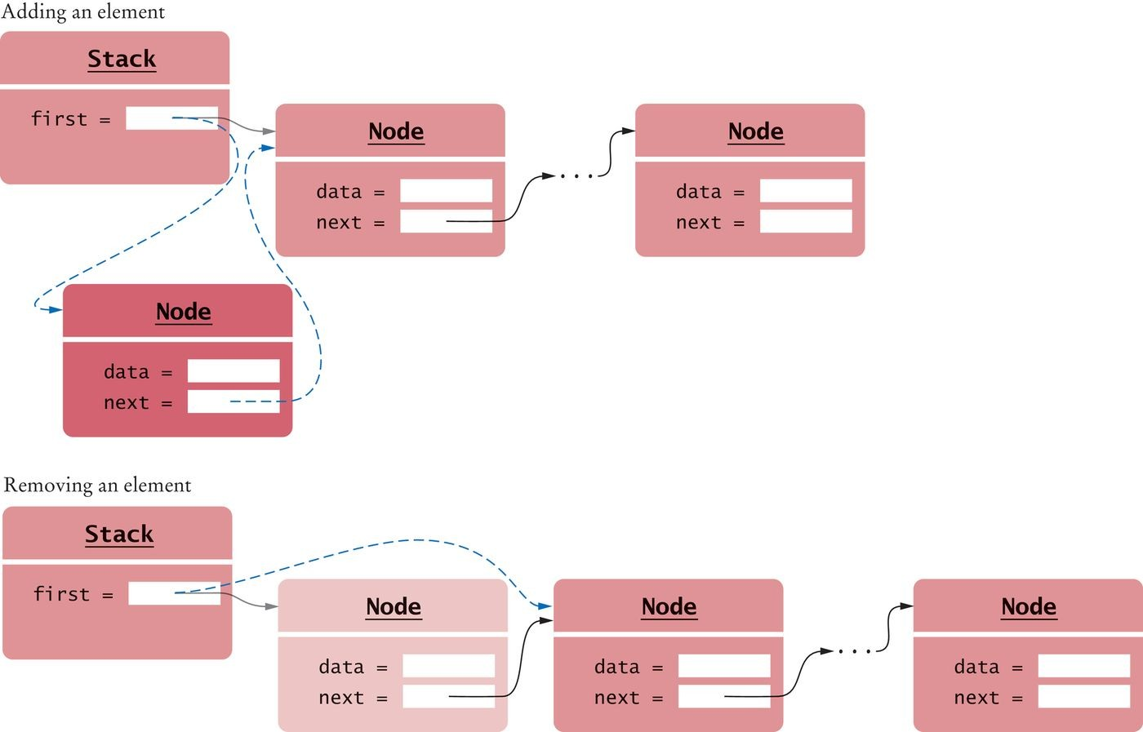
Stacks as Linked Lists
Figure 10 Push and Pop for a Stack Implemented as a Linked List

Slide 57
section_3_1/LinkedListStack.java
1 import java.util.NoSuchElementException;
2
3 /**
4 An implementation of a stack as a sequence of nodes.
5 */
6 public class LinkedListStack
7 {
8 private Node first;
9
10
11
12
13
14
15
16
17
18
19
20
21
22
23
24
25
26
27
28
29
30
31
32
33
34
35
/**
Constructs an empty stack.
*/
public LinkedListStack()
{
first = null;
}
/**
Adds an element to the top of the stack.
@param element the element to add
*/
public void push(Object element)
{
Node newNode = new Node(); newNode.data = element; newNode.next = first; first = newNode;
}
/**
Removes the element from the top of the stack.
@return the removed element
*/
public Object pop()
{

Slide 58
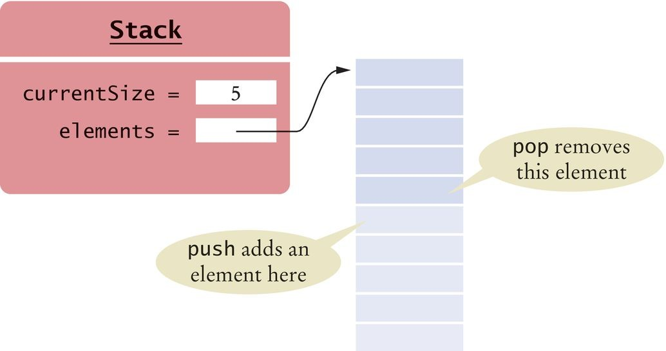
Stacks as Arrays
A stack can be implemented as an array.
Push and pop from the least expensive end - the back. The array must grow when it gets full.
The push and pop operations are identical to the addLast and removeLast
operations of an array list.
push and pop are O(1)+ operations.
Figure 11 A Stack Implemented as an Array

Slide 59
Queues as Linked Lists
A queue can be implemented as a linked list:
Add elements at the back. Remove elements at the front. Keep a reference to last element.
The add and remove operations are O(1) operations.

Slide 60
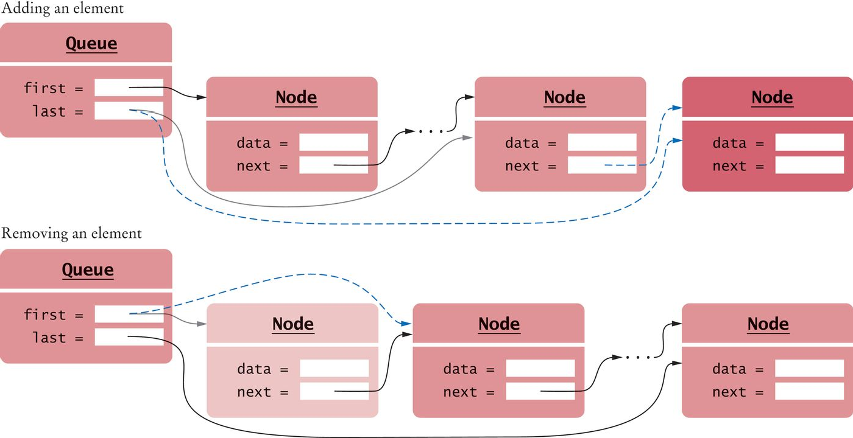
Queues as Linked Lists
Figure 12 A Queue Implemented as a Linked List

Slide 61

Queues as Circular Arrays
In a circular array, we wrap around to the beginning after the last element.
When removing elements of a circular array,
increment the index at which the head of the queue is located.
When the last element of the array is filled,
Wrap around and start storing at index 0
If elements have been removed there is room Else reallocate.
All operations except reallocating are independent of the queue size
O(1)
Reallocation is amortized constant time
O(1)+

Slide 62
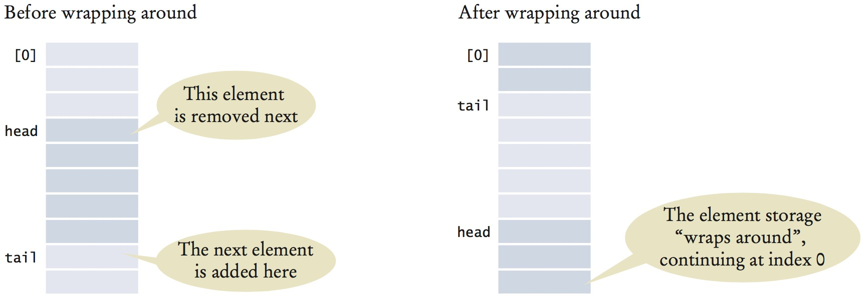
Queues as Circular Arrays
Figure 13 Queue Elements in a Circular Array

Slide 63
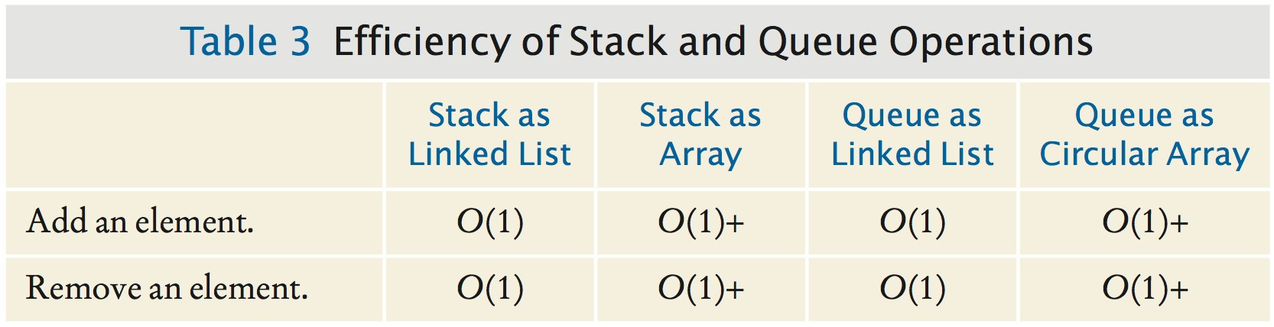
Queues as Circular Arrays

Slide 64
section_3_4/CircularArrayQueue.java
1 import java.util.NoSuchElementException;
2
3 /**
4 An implementation of a queue as a circular array.
5 */
6 public class CircularArrayQueue
7 {
private Object[] elements;
private int currentSize;
private int head;
private int tail;
12
13
14
15
16
17
18
19
20
21
22
23
24
25
26
27
28
29
30
31
32
33
34
35
/**
Constructs an empty queue.
*/
public CircularArrayQueue()
{
final int INITIAL_SIZE = 10; elements = new Object[INITIAL_SIZE]; currentSize = 0;
head = 0;
tail = 0;
}
/**
Checks whether this queue is empty.
@return true if this queue is empty
*/
public boolean empty() { return currentSize == 0; }
/**
Adds an element to the tail of this queue.
@param newElement the element to add
*/
public void add(Object newElement)

Slide 65
Self Check 16.13
Add a method peek to the Stack implementation in Section 16.3.1 that returns the top of the stack without removing it.
Answer:
public Object peek()
{
if (first == null)
{
throw new NoSuchElementException();
}
return first.data;
}

Slide 66
Self Check 16.14
When implementing a stack as a sequence of nodes, why isn't it a good idea to push and pop elements at the back end?
Answer: Removing an element from a singly-linked list is O(n).

Slide 67
Self Check 16.15
When implementing a stack as an array, why isn’t it a good idea to push and pop elements at index 0?
Answer: Adding and removing an element at index 0 is O(n).

Slide 68
Self Check 16.16
What is wrong with this implementation of the empty method for the circular array queue?
public boolean empty()
{
return head == 0 && tail == 0;
}
Answer: The queue can be empty when the head and tail are at a position other than zero. For example, after the calls q.add(obj) and q.remove(), the queue is empty, but head and tail are 1.

Slide 69
Self Check 16.17
What is wrong with this implementation of the empty method for the circular array queue?
public boolean empty()
{
return head == tail;
}
Answer: Indeed, if the queue is empty, then the head and tail are equal. But that situation also occurs when the array is completely full.

Slide 70
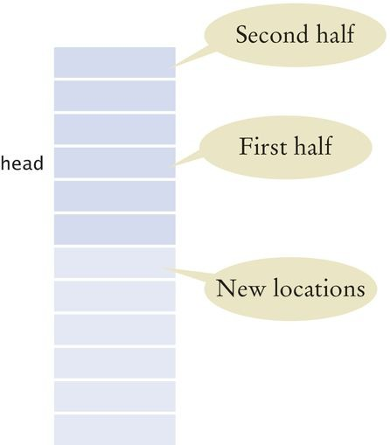
Self Check 16.18
Have a look at the growIfNecessary method of the CircularArrayQueue class. Why isn’t the loop simply:
for (int i = 0; i < elements.length; i++)
{
newElements[i] = elements[i];
}
Answer: Then the circular wrapping wouldn't work. If we simply added new elements without reordering the existing ones, the new array layout would be

Slide 71
Implementing a Hash Table
In the Java library sets are implemented as hash sets and tree sets. Hashing: place items into an array at an index determined from the element. Hash code: an integer value that is computed from an object,
in such a way that different objects are likely to yield different hash codes.
Collision: when two or more distinct objects have the same hash code. A good hash function minimizes collisions.
A hash table uses the hash code to determine where to store each element.

Slide 72
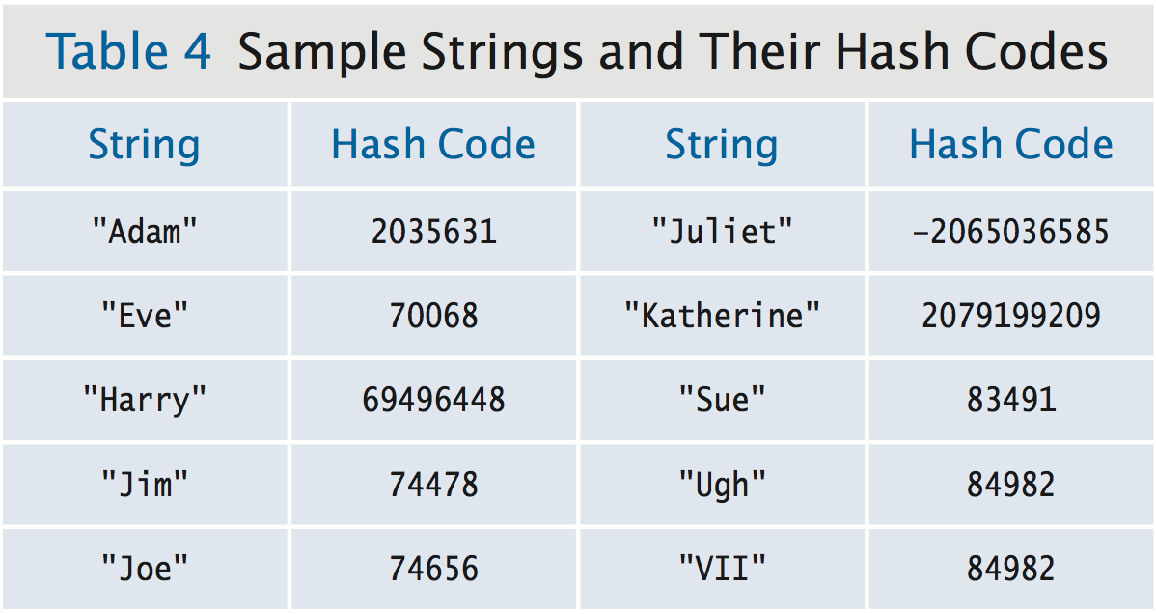
Implementing a Hash Table

Slide 73
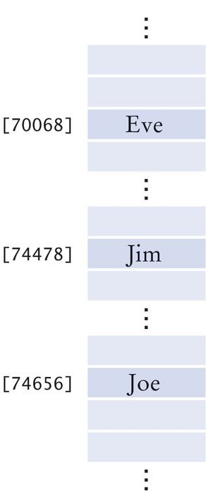
Hash Tables
Hash table: An array that stores the set elements. Hash code: used as an array index into a hash table. Simplistic implementation
Very large array
Each object at its hashcode location Simple to locate an element
But not practical
Figure 14 A Simplistic Implementation of a Hash Table

Slide 74
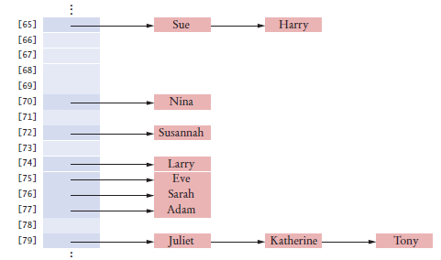
Hash Tables - Realistic Implementation
A reasonable size array.
Use the remainder operator to calculate the position.
int h = x.hashCode(); if (h < 0) { h = -h; }
position = h % arrayLength;
Use separate chaining to handle collisions:
All colliding elements are collected in a linked list of elements with the same position value. The lists are called buckets.
Each entry of the hash table points to a sequence of nodes containing elements with the same hash code.
A hash table can be implemented as an array of buckets—sequences of nodes that hold elements with the same hash code.
Figure 15 A Hash Table with Buckets to Store Elements with the Same Hash Code

Slide 75

Hash Tables
Elements with the same hash code are placed in the same bucket.

Slide 76
Implementing a Hash Table - Finding an Element
Algorithm to find an element, obj
Compute the hash code and compress it.
Gives an index h into the hash table.
Iterate through the elements of the bucket at position h.
Check element is equal to obj.
If a match is found among the elements of that bucket,
obj is in the set. Otherwise, it is not.
If there are no or only a few collision:
adding, locating, and removing hash table elements takes O(1) time.

Slide 77
Adding and Removing Elements
Algorithm to add an element:
Compute the compressed hash code h.
Iterate through the elements of the bucket at position h.
For each element of the bucket, check whether it is equal to obj.
If a match is found among the elements of that bucket, then exit.
Otherwise, add a node containing obj to the beginning of the node sequence. If the load factor exceeds a fixed threshold, reallocate the table.
Load factor: a measure of how full the table is.
The number of elements in the table divided by the table length.
Adding an element to a hash table is O(1)+

Slide 78
Adding and Removing Elements
Algorithm to remove an element:
Compute the hash code to find the bucket that should contain the object. Try to find the element.
If it is present:
remove it.
otherwise, do nothing.
Shrink the table if it becomes too sparse.
Removing an element from a hash table is O(1)+

Slide 79
Iterating over a Hash Table
When iterator points to the middle of a node chain,
easy to get the next element.
When the iterator is at the end of a node chain,
Skip over empty buckets.
Advance the iterator to the first node of the first non-empty bucket.
Iterator needs to store the bucket number and a reference to the current node in the node chain.
if (current != null && current.next != null)
{
current = current.next; // Move to next element in bucket
}
else // Move to next bucket
{
do
{
bucketIndex++;
if (bucketIndex == buckets.length)
{
throw new NoSuchElementException();
}
current = buckets[bucketIndex];
}
while (current == null);
}

Slide 80
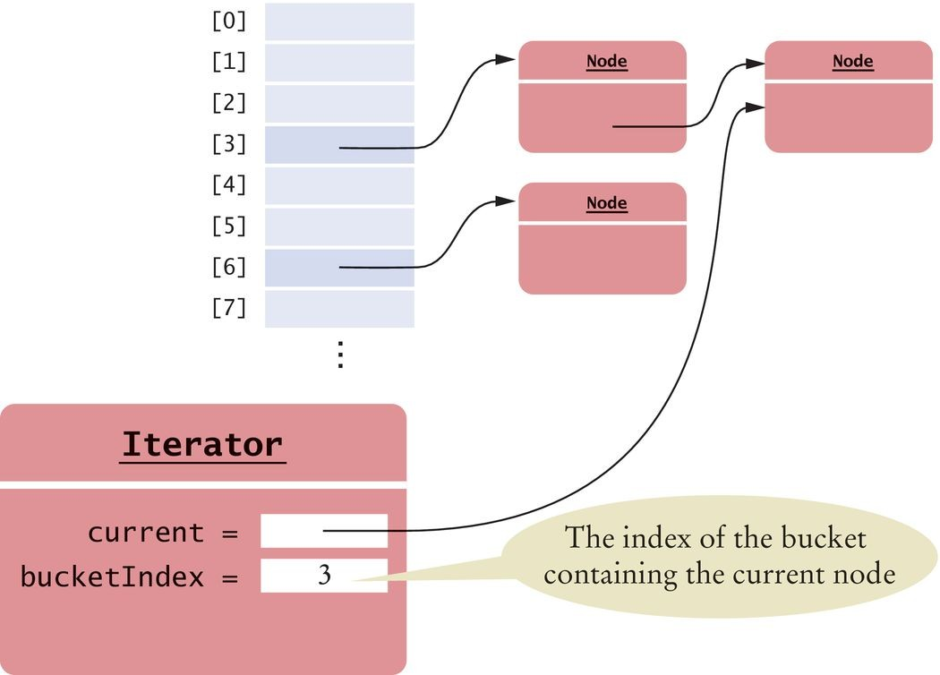
Iterating over a Hash Table
Figure 16 An Iterator to a Hash Table

Slide 81
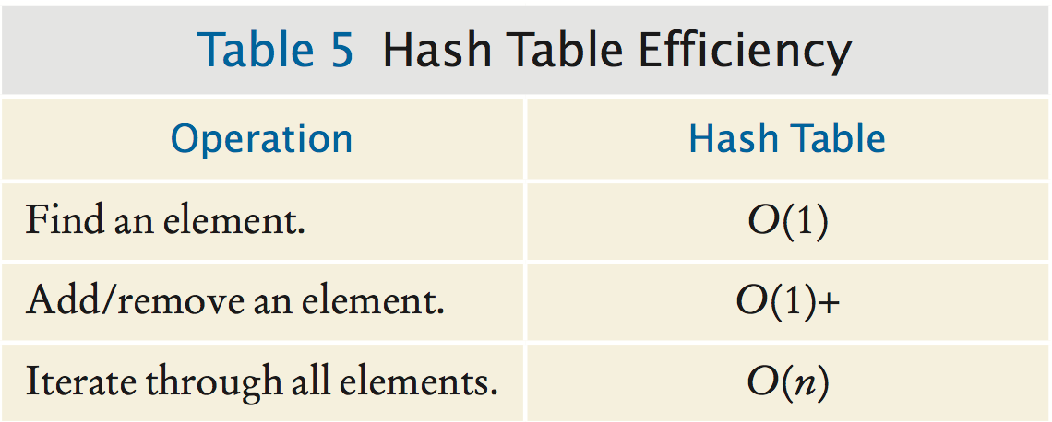
Hash Table Efficiency
The cost of iterating over all elements of a hash table:
Is proportional to the table length
Not the number of elements in the table
Shrink the table when the load factor gets too small. One iteration is O(1).
Iterating over the entire table is O(n).

Slide 82
section_4/HashSet.java
import java.util.Iterator;
import java.util.NoSuchElementException;
3
4 /**
5 This class implements a hash set using separate chaining.
6 */
7 public class HashSet
8 {
private Node[] buckets;
private int currentSize;
11
12
13
14
15
16
17
18
19
20
21
22
23
24
25
26
27
28
29
30
31
32
33
34
35
/**
Constructs a hash table.
@param bucketsLength the length of the buckets array
*/
public HashSet(int bucketsLength)
{
buckets = new Node[bucketsLength]; currentSize = 0;
}
/**
Tests for set membership.
@param x an object
@return true if x is an element of this set
*/
public boolean contains(Object x)
{
int h = x.hashCode(); if (h < 0) { h = -h; } h = h % buckets.length;
Node current = buckets[h]; while (current != null)
{

Slide 83
section_4/HashSetDemo.java
1 import java.util.Iterator;
2
3 /**
4 This program demonstrates the hash set class.
5 */
6 public class HashSetDemo
7 {
8 public static void main(String[] args)
9 {
10 HashSet names = new HashSet(101);
11
12
13
14
15
16
17
18
19
20
21
22
23
24
25
26
27
28
29
30
31
32
33 }
names.add("Harry");
names.add("Sue");
names.add("Nina"); names.add("Susannah"); names.add("Larry");
names.add("Eve");
names.add("Sarah");
names.add("Adam");
names.add("Tony"); names.add("Katherine"); names.add("Juliet"); names.add("Romeo"); names.remove("Romeo"); names.remove("George");
Iterator iter = names.iterator(); while (iter.hasNext())
{
System.out.println(iter.next());
}
}

Slide 84
Program Run:
Harry Sue Nina
Susannah Larry Eve Sarah Adam Juliet
Katherine Tony

Slide 85
Self Check 16.19
If a hash function returns 0 for all values, will the hash table work correctly?
Answer: Yes, the hash set will work correctly. All elements will be inserted into a single bucket.

Slide 86
Self Check 16.20
If a hash table has size 1, will it work correctly?
Answer: Yes, but there will be a single bucket containing all elements. Finding, adding, and removing elements is O(n).

Slide 87
Self Check 16.21
Suppose you have two hash tables, each with n elements. To find the elements that are in both tables, you iterate over the first table, and for each element, check whether it is contained in the second table. What is the big-Oh efficiency of this algorithm?
Answer: The iteration takes O(n) steps. Each step makes an O(1) containment check. Therefore, the total cost is O(n).

Slide 88
Self Check 16.22
In which order does the iterator visit the elements of the hash table?
Answer: Elements are visited by increasing (compressed) hash code. This ordering will appear random to users of the hash table.

Slide 89
Self Check 16.23
What does the hasNext method of the HashSetIterator do when it has reached the end of a bucket?
Answer: It locates the next bucket in the bucket array and points to its first element.

Slide 90
Self Check 16.24
Why doesn’t the iterator have an add method?
Answer: In a set, it doesn’t make sense to add an element at a specific position.

